Slide 1
CHOOSING THE SLOGAN

Slide 2
1. Easy to pronounce
If it is not easy to pronounce it will not be remembered.

Slide 3
2. It should describe the company
If the name does not do it, the slogan must.

Slide 4
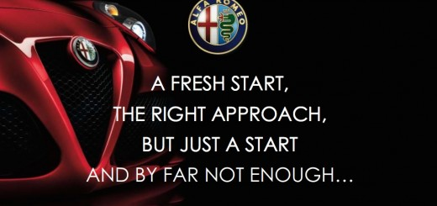
3. Less than eight words
A long slogan will not be easy to remember. You must not use more than 8 words.

Slide 5
4. Few syllables
The words should have few syllables. Long words will not be remembered easily.

Slide 6
Notes:
https://www.youtube.com/watch?v=ZwUtKP4ZEqg

Slide 7
5. What in your brand? Summarize it.
In the slogan you should summarize what your company does, if it is not related to it, you will not advertise yourself properly.

Slide 8
6.Daily conversations
The slogan should be easy to use in your daily conversations.
Notes:
https://www.youtube.com/watch?v=M5xtmyujdZs

Slide 9
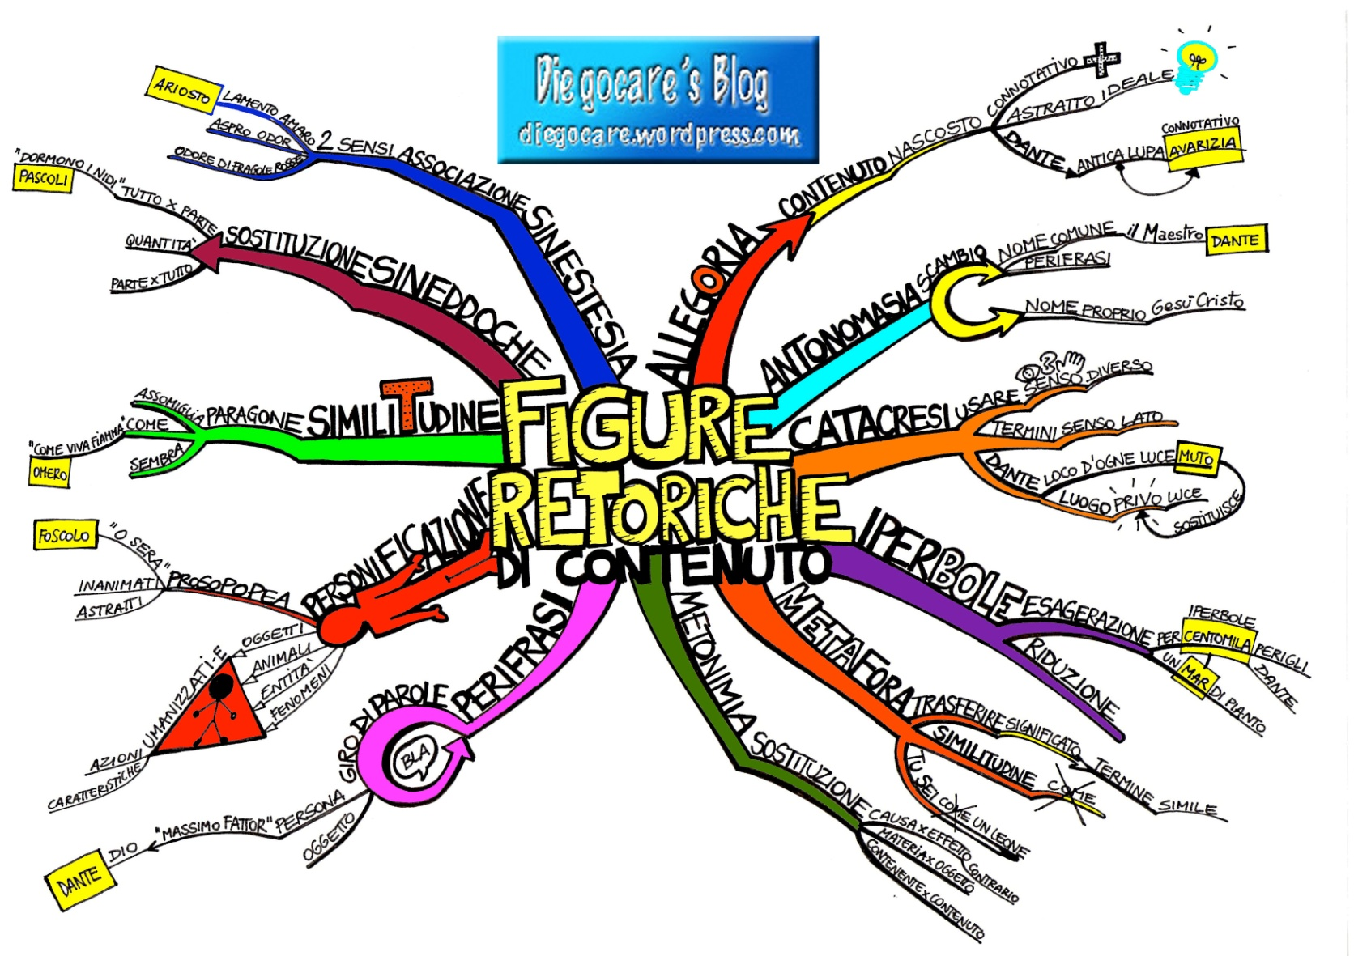
7. Why not using figures of speech?
Notes:
http://estriemaestri.altervista.org/le-figure-retoriche-della-pubblicita/

Slide 10
Examples:
La rima
Notes:
https://www.youtube.com/watch?v=W0ctVnMaBgg
http://estriemaestri.altervista.org/le-figure-retoriche-della-pubblicita/

Slide 11
Allitterazione

Slide 12
Climax

Slide 13
Antitesi

Slide 14
Good luck ☺

